Slide 1
NRF24 Module
Atmega
328
NRF24
L01+
(IRQ)
D7
CE
3
8
CSN
No connection
D8
4
D11
MOSI
6
D12
MISO
7
D13
SCK
5
2
1
Power Supply
3.3 V
10MF

Slide 2
Modules
PIR sensor
https://www.amazon.in/Generic-HC-SR501-Sensor-Pyroelectric-Infrared/dp/B00VNWWZM0/
Microwave radar
https://www.amazon.in/RCWL-0516-Microwave-Sensor-Module-Induction/dp/B0766526C1/
Wireless module NRF24 L01+
https://www.amazon.in/REES52-NRF24L01-Wireless-Transceiver-Arduino/dp/0070923507/
https://drive.google.com/file/d/1W67ppn7uSWa2VNqlO8Iq-rq3CgTfgZlq/view
https://howtomechatronics.com/tutorials/arduino/arduino-wireless-communication-nrf24l01-tutorial/
http://www.satistronics.com/mini-24ghz-wireless-nrf24l01-nrf24l01-transceiver-module_p2450.html
https://abdullahdemirci.jimdo.com/arduino-projeleri/nrf24l01-arduino-mega/

Slide 3
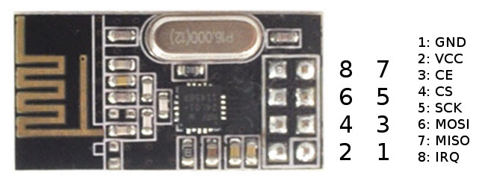
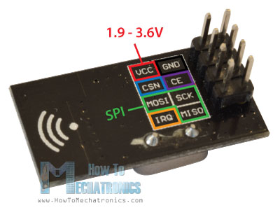
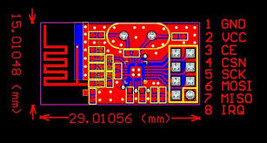
NRF 24

Slide 4
Universal connector
1
2
3
4
5
Pin 1 and 5 are connected
5V
5V
Signal
Gnd
Signal
5V
Pin 2 and 4 are connected
5V
5V
5V
Signal
Gnd
Signal
5V
5V
Signal
Gnd
Signal
5V
5V
Signal
Gnd
Gnd
Signal
5V
Magnetic
Radar
PIR
Sensor

